Slide 1
Digital Portfolio
STUDENT NAME:Aruna.A
REGISTER NO AND NMID: 3D17FAA9A492B438Bb6417B97E9FE4F8
DEPARTMENT: Bsc.Computer science
COLLEGE: COLLEGE/ UNIVERSITY: Immaculate college/Annamalai University

Slide 2
PROJECT TITLE
Student attendance management

Slide 3


AGENDA
Problem Statement
Project Overview
End Users
Tools and Technologies
Portfolio design and Layout
Features and Functionality
Results and Screenshots
Conclusion
Github Link
3/21/2024 Annual Review

Slide 4

PROBLEM STATEMENT
problem statement usually describes:1. The current situation (what’s happening now).2. The gap or issue (what’s wrong or missing).3. The impact (why it matters).4. The objective (what needs to be solved).

Slide 5

PROJECT OVERVIEW
📌 Project Overview
Project Title:
Student Attendance Management System
Background / Context:
In many educational institutions, attendance is still recorded manually in registers or spreadsheets. This method is time-consuming, prone to human error, and lacks transparency for parents and administrators. With the growing need for digital transformation in education, an automated attendance management system is essential.
Problem Statement:
Manual attendance tracking lacks efficiency, accuracy, and real-time monitoring.

Slide 6

WHO ARE THE END USERS?
📌 1. Online Resume Builder
End Users:
Job Seekers → students, fresh graduates, professionals creating or updating resumes
Recruiters / HR teams (indirect users) → benefit from receiving ATS-friendly resumes
Career counselors / Placement officers → guide students in building better resumes
📌 2. Student Attendance Management System
End Users:
Teachers / Faculty → record and monitor attendance quickly
Students → track their attendance in real time
Parents / Guardians → receive alerts about absences or low attendance
School / College Administrators → analyze attendance reports, compliance, and performance trends

Slide 7

TOOLS AND TECHNIQUES
📌 1. Project Management
Tools
Microsoft Project, Jira, Trello, Asana
Gantt Charts, Kanban Boards
Collaboration platforms (Slack, MS Teams, Zoom)
Techniques
Work Breakdown Structure (WBS)
Critical Path Method (CPM)
Agile / Scrum / Kanban
Risk analysis and management
Stakeholder analysis
📌 2. Research & Problem Solving
Tools
Surveys (Google Forms, SurveyMonkey)
Data analysis software (SPSS, R, Python, Excel)
Literature databases (Google Scholar, PubMed, IEEE Xplore)

Slide 8
📑 Portfolio Layout Structure
1. Cover / Introduction
Name, tagline, professional role (e.g., "UI/UX Designer | Creative Thinker").
A short personal statement or career objective.
2. Table of Contents (for PDF/printed portfolios)
Helps readers quickly find relevant sections.
3. About Me
Background, education, skills.
Short professional bio with personality.
4. Skills & Expertise
Highlight technical, creative, or professional skills.
Can use icons, progress bars, or infographics for visual
🖥️ Types of Portfolio Layouts
Minimalist Layout – Clean, simple, focus on work samples.
Grid Layout – Projects displayed in a grid (common for design/art portfolios).
Timeline Layout – Great for showing career progression.
Interactive Layout (digital portfolios) – With clickable navigation, animations, or case study pOp-uPs
POTFOLIO DESIGN AND LAYOUT
8

Slide 9
FEATURES AND FUNCTIONALITY
🔹 Features
These are the visible qualities or characteristics of a system, product, or portfolio — basically what it has.
Examples:
For a portfolio → “Clean, minimalist layout”, “Mobile-friendly design”, “Downloadable PDF option”.
For a website → “User login”, “Search bar”, “Dark mode”.
For a software/app → “Dashboard view”, “Notifications”, “Data export”.
🔹 Functionality
This describes the purpose and working ability — basically what it does.
Examples:
For a portfolio → “Allows recruiters to view projects interactively”, “Enables easy contact via form”.
For a website → “Search bar retrieves information quickly”, “Login secures personal data”.
For a software/app → “Generates attendance reports”, “Sends automated reminders.

Slide 10
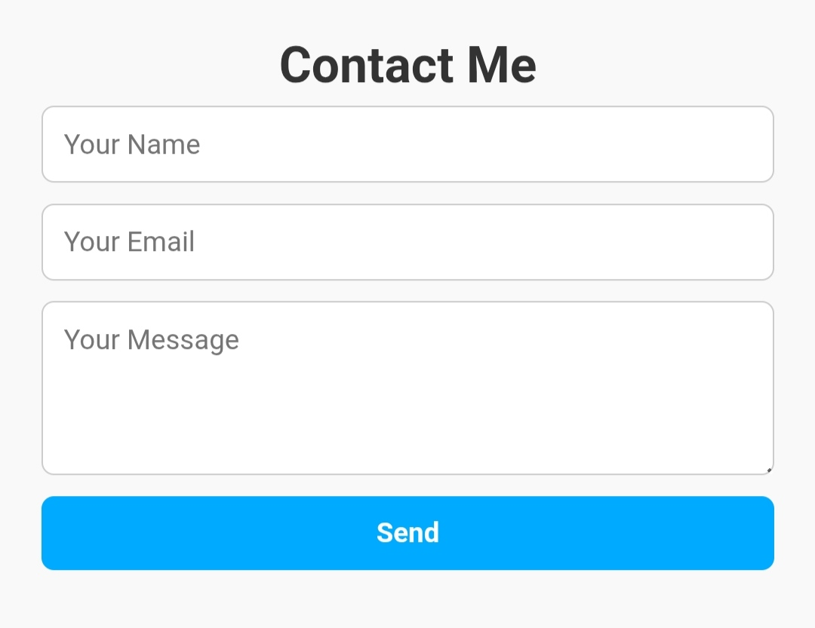

RESULTS AND SCREENSHOTS
3/21/2024 Annual Review
10

Slide 11
CONCLUSION
📌 Conclusion (Sample Write-up)
The portfolio project was successfully designed and developed with a focus on clarity, usability, and professional presentation. It provides an organized platform to showcase personal skills, academic achievements, and project work in a visually appealing manner.
The project met its primary objectives by:
Creating a user-friendly layout with smooth navigation.
Highlighting key skills and accomplishments effectively.
Ensuring compatibility across devices through a responsive design.
Demonstrating both creativity and technical knowledge.
This portfolio not only serves as a professional showcase but also as a personal branding tool, making it easier to present qualifications to potential employers, clients, or academic institutions. In the future, the portfolio can be enhanced with additional interactive features, multimedia elements, and continuous updates as new projects and skills are acquired.
11

